Slide 1
CIS 115
Introduction to Computing Science
Informatics, Data Science, Big Data:
Topics, Applications, and Careers
William H. Hsu
Department of Computing and Information Sciences, KSU
http://www.cis.ksu.edu/~bhsu
Laboratory for Knowledge Discovery in Databases
http://www.kddresearch.org
This talk is: http://bit.ly/kstate-informatics-fs2016
Other resources:
http://bit.ly/kstate-CIS115-F2014
Visualization intro: http://bit.ly/kstate-cgclass-infovis-VDQI
On studying media arts (IUPUI): http://bit.ly/media-arts-iupui-zajac

Slide 2
Outline
What are Data Science, Big Data, and Analytics?
What Is Informatics? How Is It Relevant to Computer Science?
Applied computational, information science
Domains: arts, sciences, medicine, law
Tasks: analytics, visualization, data/info integration
Motivating Areas, Examples, Sources
Info Visualization, Big Data Analytics, & The Ghost Map
Informatics in the Sciences: Bioinformatics and Beyond
Digital Humanities and Media Arts
Media Sciences: Mass Communications to Text Analytics
Medical and Health Informatics

Slide 3

Business Intelligence (BI) &
Customer Relationship Management
http://bit.ly/datamining-target-teenpreg, http://bit.ly/datamining-ethics-teenpreg
“How Target Figured Out A Teen Girl Was Pregnant Before Her Father Did” (Hill, 2012)
See also: http://bit.ly/seeing-state – Seeing Like a State (Scott, 1999)

Slide 4
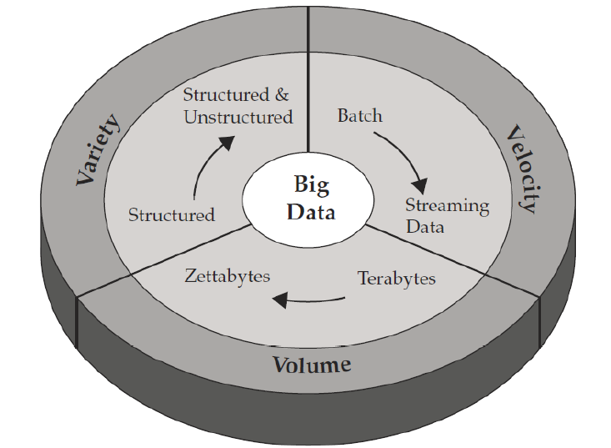
Characterizing Big Data:
Three V’s – Volume, Velocity, Variety
Adapted from slide © 2012, M. Grobelnik
http://bit.ly/bigdata-tutorial-grobelnik

Slide 5
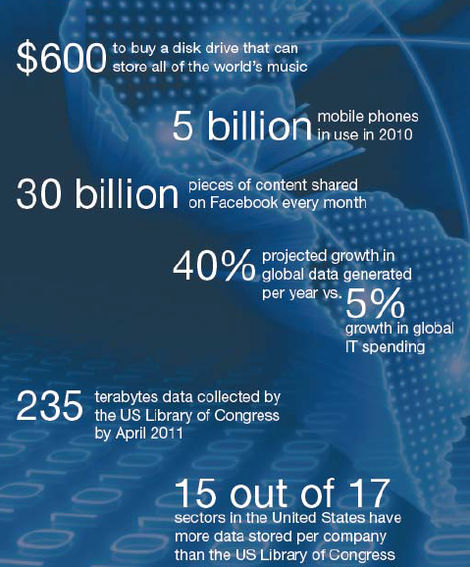
How Much Is There?
A Growing Torrent (2012)
Adapted from slide © 2012, M. Grobelnik
http://bit.ly/bigdata-tutorial-grobelnik

Slide 6
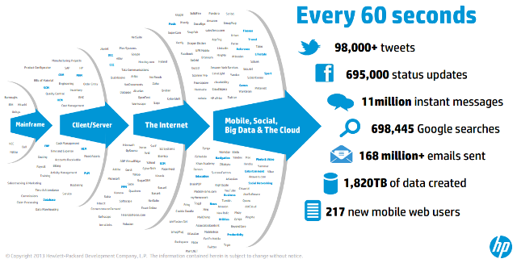
Sources: Web & Mobile Content, Messaging, Search, Social Media
© 2013, Hewlett-Packard
http://bit.ly/what-is-big-data-hp

Slide 7
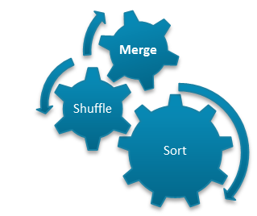
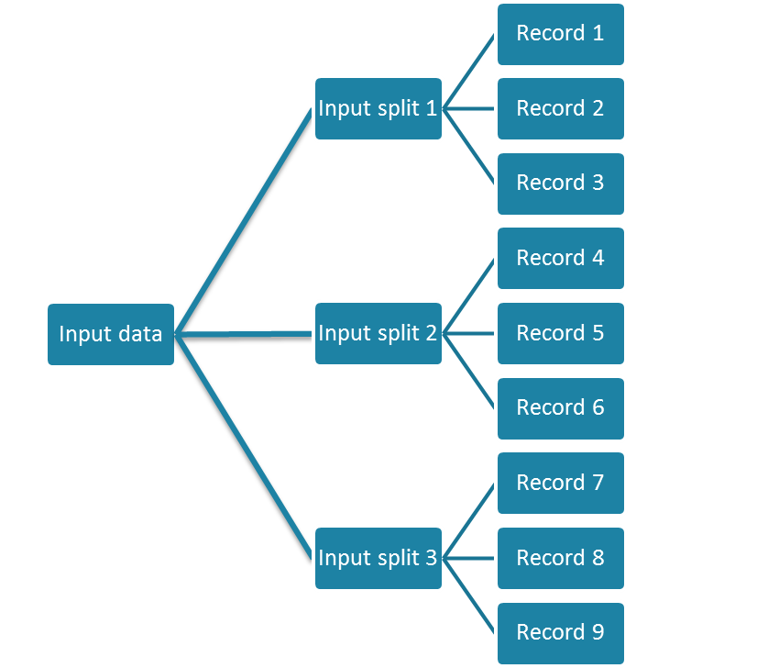
MapReduce in a nutshell
Task1
Aggregated Result
Task 2
Output data
Aggregated Result
Task 3
© Sven Schlarb
7

Slide 8
Distributed Grep
Split data
grep
matches
Split data
grep
matches
Very
big
data
All
matches
Split data
grep
matches
cat
Split data
grep
matches
© 2006, H. Setiawan, National University of Singapore
http://bit.ly/mapreduce-intro-setiawan

Slide 9
Outline
What are Data Science, Big Data, and Analytics?
What Is Informatics? How Is It Relevant to Computer Science?
Applied computational, information science
Domains: arts, sciences, medicine, law
Tasks: analytics, visualization, data/info integration
Motivating Areas, Examples, Sources
Info Visualization, Big Data Analytics, & The Ghost Map
Informatics in the Sciences: Bioinformatics and Beyond
Digital Humanities and Media Arts
Media Sciences: Mass Communications to Text Analytics
Medical and Health Informatics

Slide 10
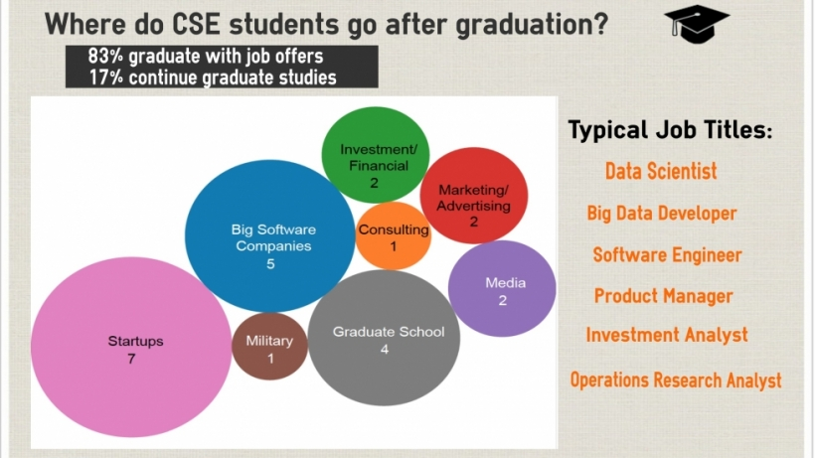
Jobs! Careers in
Data Science & Informatics
© 2010 – 2014, Harvard Institute for Applied Computational Science
http://iacs.seas.harvard.edu
Notes:
10

Slide 11
What Is Informatics?
Informatics as Applied Computing: Building Blocks
Information & Knowledge Management
Analytics: Applied Data Science
Systems: Info Technology – Software & Techniques
Aspects: Lowe (Stanford); Zitner (Dalhousie)
Practice: Products, Strategy, Clinical Care
Applications & Services
Analytics: Seeing Emerging Issues & Trends
Decision Support: Recommendations & More
Research: Basic & Applied Science, Development
Education: Engaging STEM, Digital Humanities

Slide 12
Outline
What are Data Science, Big Data, and Analytics?
What Is Informatics? How Is It Relevant to Computer Science?
Applied computational, information science
Domains: arts, sciences, medicine, law
Tasks: analytics, visualization, data/info integration
Motivating Areas, Examples, Sources
Info Visualization, Big Data Analytics, & The Ghost Map
Informatics in the Sciences: Bioinformatics and Beyond
Digital Humanities and Media Arts
Media Sciences: Mass Communications to Text Analytics
Medical and Health Informatics

Slide 13
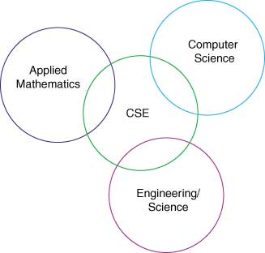
Applied Computational Sciences & Engineering (CSE)
© 2006, Society for Industrial and Applied Mathematics (SIAM)
http://www.siam.org/students/resources/report.php

Slide 14
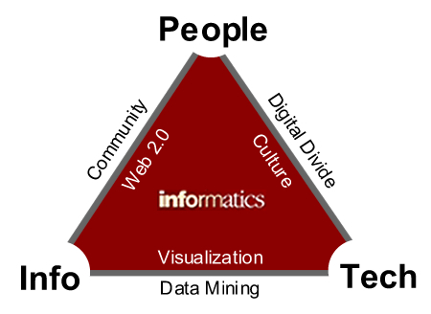
Informatics & Computing Science [1]
© 2007 K. Makice
http://bit.ly/what-is-informatics-makice-2007

Slide 15
Informatics & Computing Science [2]
Technology impacting Information: Extracting meaning from large data sets
Information impacting Technology: Innovation to technology driven by new data collections
People impacting Information: Creating, manipulating content to produce new informational value
Information impacting People: Connections made or strengthened through aggregation of existing information
People impacting Technology: Social and political policy that affects access to and development of technology
Technology impacting People: The cultural changes resulting from the introduction and use of technology
© 2007 K. Makice
http://bit.ly/what-is-informatics-makice-2007

Slide 16
Outline
What are Data Science, Big Data, and Analytics?
What Is Informatics? How Is It Relevant to Computer Science?
Applied computational, information science
Domains: arts, sciences, medicine, law
Tasks: analytics, visualization, data/info integration
Motivating Areas, Examples, Sources
Info Visualization, Big Data Analytics, & The Ghost Map
Informatics in the Sciences: Bioinformatics and Beyond
Digital Humanities and Media Arts
Media Sciences: Mass Communications to Text Analytics
Medical and Health Informatics

Slide 17
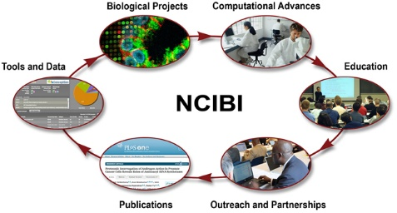

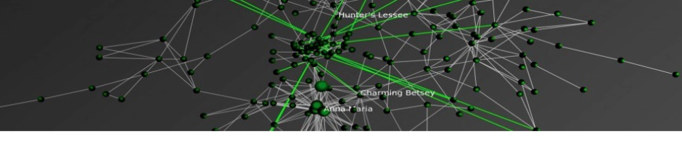
Informatics in Many Domains:
Arts, Sciences, Medicine, Law
Computational Medicine, Heath, & Biology
(Bioinformatics & Medical/Health Informatics)
http://portal.ncibi.org/gateway/
Digital Arts
http://bit.ly/digitalarts-tutorials
Citation Network of
U.S. Supreme Court Decisions
(Bommarito et al., 2010)
Computational Law
http://bit.ly/complaw-citation-net

Slide 18
Outline
What are Data Science, Big Data, and Analytics?
What Is Informatics? How Is It Relevant to Computer Science?
Applied computational, information science
Domains: arts, sciences, medicine, law
Tasks: analytics, visualization, data/info integration
Motivating Areas, Examples, Sources
Info Visualization, Big Data Analytics, & The Ghost Map
Informatics in the Sciences: Bioinformatics and Beyond
Digital Humanities and Media Arts
Media Sciences: Mass Communications to Text Analytics
Medical and Health Informatics

Slide 19
Visualization [1]:
Definitions
Wikipedia: “Using Images, Diagrams, Animations to Communicate”
Images: illustrations; photographs, especially modified photos
Diagrams: structural diagrams, blueprints, plots & charts
Animations: based on simulation or other specifications
Includes, But Not Limited to, Statistical Graphics
Kinds of Visualization (Often Abbreviated “Vis” cf. IEEE InfoVis)
Scientific: transformation, representation of data for exploration
Data: schematic form
e.g., relational database form (tuples of attribute values)
“Data vis” often synonymous with “statistical vis”
Information: spectrum from “raw data” to “info”, “knowledge”
Premise: info more structured, organized, abstract than data
Emphasis on computational tools
Working with (especially analyzing) large data sets
Adapted from book material © 2001 E. R. Tufte, Yale University
The Visual Display of Quantitative Information, Graphics Press: http://bit.ly/16Se1

Slide 20
Outline
What are Data Science, Big Data, and Analytics?
What Is Informatics? How Is It Relevant to Computer Science?
Applied computational, information science
Domains: arts, sciences, medicine, law
Tasks: analytics, visualization, data/info integration
Motivating Areas, Examples, Sources
Info Visualization, Big Data Analytics, & The Ghost Map
Informatics in the Sciences: Bioinformatics and Beyond
Digital Humanities and Media Arts
Media Sciences: Mass Communications to Text Analytics
Medical and Health Informatics

Slide 21
Outline
What are Data Science, Big Data, and Analytics?
What Is Informatics? How Is It Relevant to Computer Science?
Applied computational, information science
Domains: arts, sciences, medicine, law
Tasks: analytics, visualization, data/info integration
Motivating Areas, Examples, Sources
Info Visualization, Big Data Analytics, & The Ghost Map
Informatics in the Sciences: Bioinformatics and Beyond
Digital Humanities and Media Arts
Media Sciences: Mass Communications to Text Analytics
Medical and Health Informatics

Slide 22
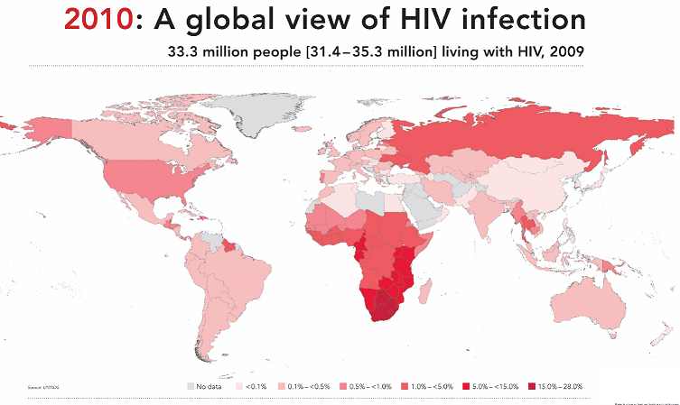


Visualization [2]:
Thematic Maps
Data Maps: Visual Presentation of Variables over Region (e.g., Spatial)
Thematic Map: Shows Topic (Theme) Referenced by Geographic Area
Wikipedia: http://en.wikipedia.org/wiki/Thematic_map
Example: 2010 UNAIDS Report on Global HIV Infection Rates
© 2010, UNAids
http://bit.ly/ftHhd4
Inspired by book material © 2001 E. R. Tufte, Yale University
The Visual Display of Quantitative Information, Graphics Press: http://bit.ly/16Se1

Slide 23
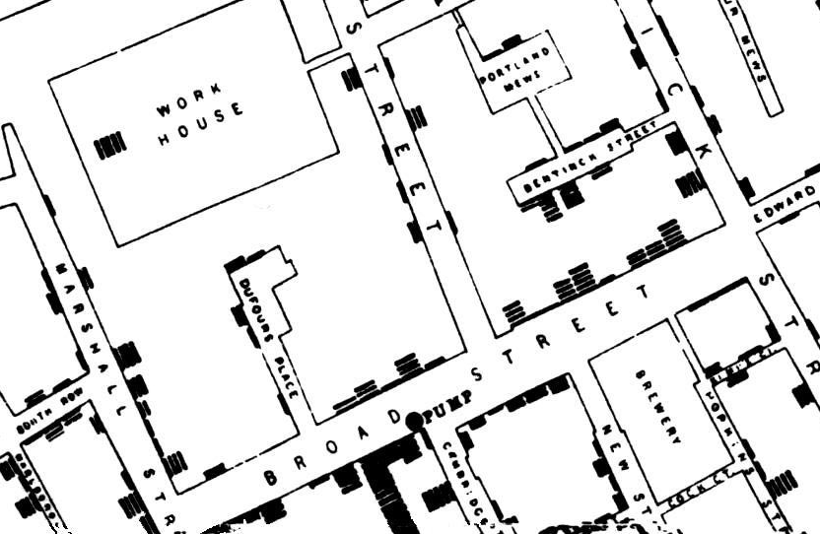


The Ghost Map:19th Century Info Vis & Public Health Policy
Snow, J. (1854)
See also: Johnson, S. (2006). The Ghost Map.
2014 Kansas State Book Network (KSBN) Common Reader

Slide 24
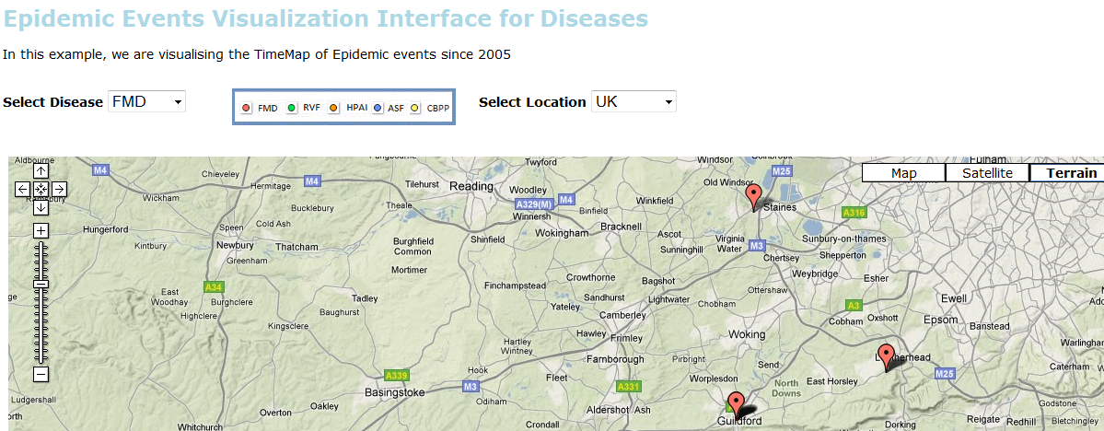
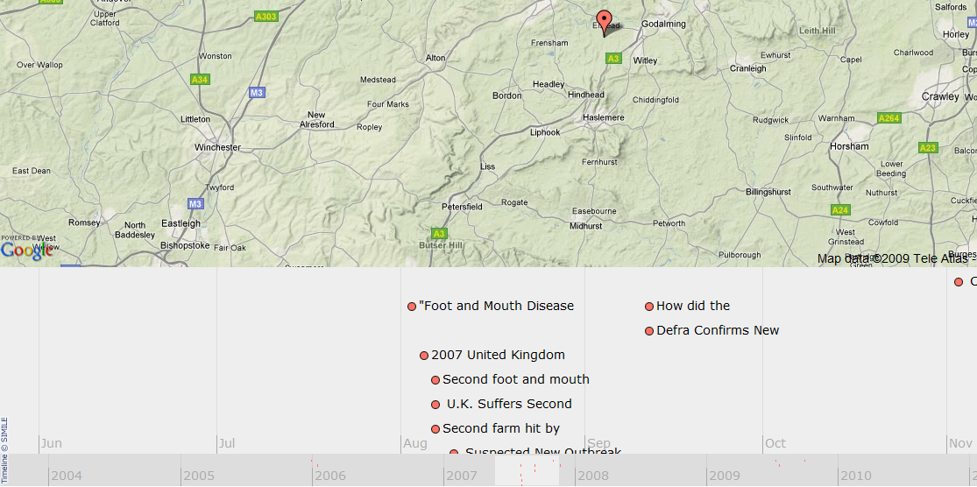
21st Century Thematic Mapping:
Summarizing News from The Web
http://fingolfin.user.cis.ksu.edu/timemap2gs
Based on
NLP Group NER Toolkit © 2005-2010 Stanford University
Simile © 2003-2010 Massachusetts Institute of Technology
Google Maps © 2007-2010 Tele Atlas, Inc. and Google, Inc.

Slide 25
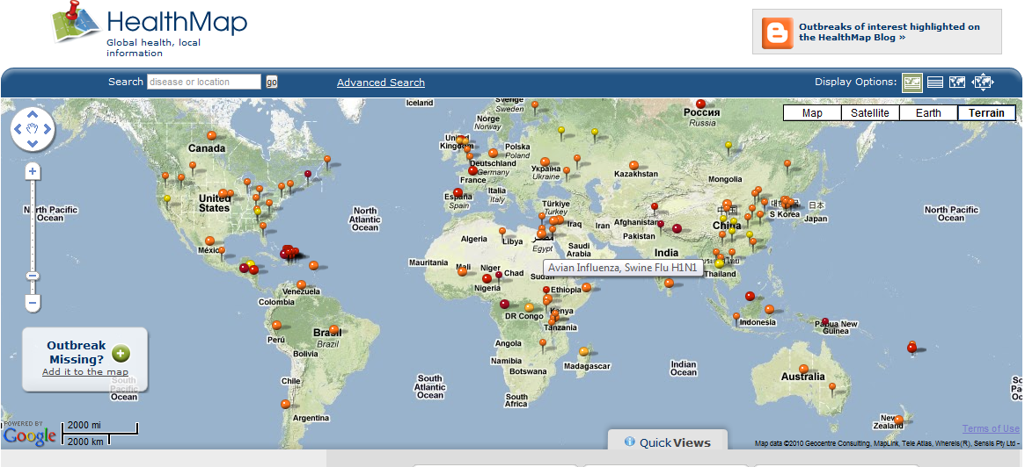
Thematic Mapping in HealthMap [1]:
Outbreaks in Google Maps
http://healthmap.org
© 2006 – 2013 Brownstein, J. & Freifeld, C.

Slide 26
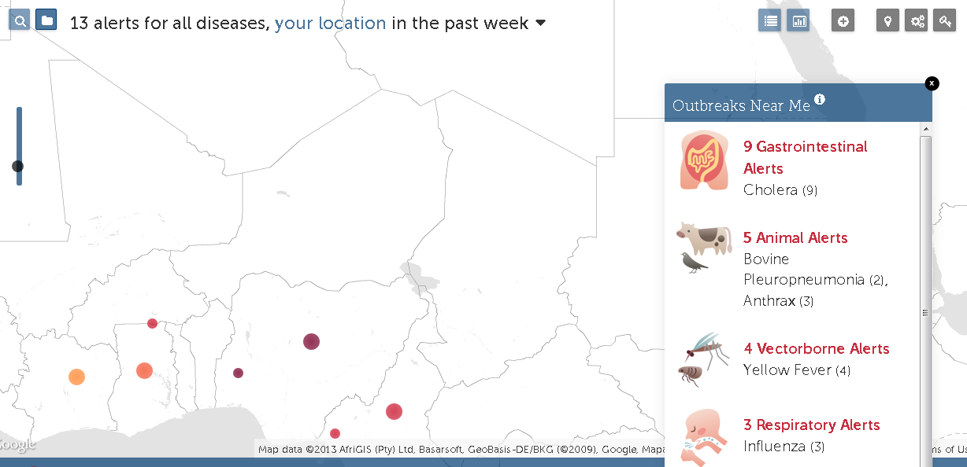
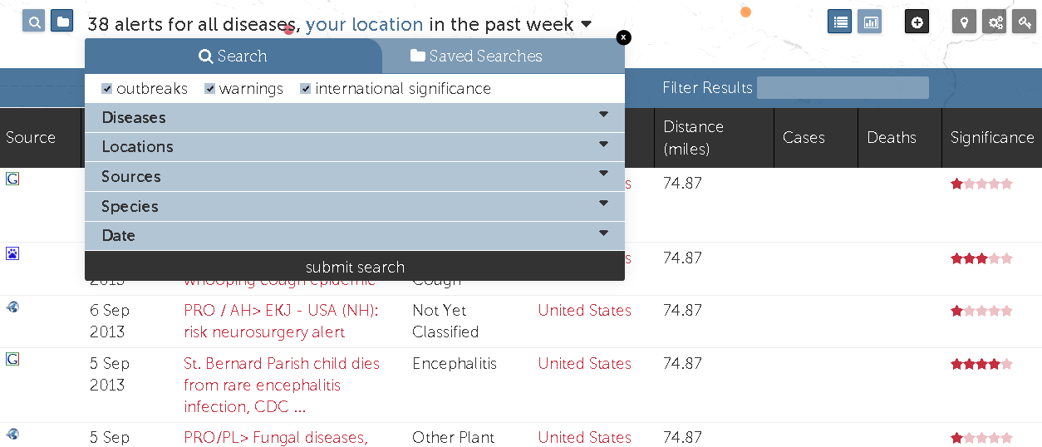
Thematic Mapping in HealthMap [2]:
Drilling Down
http://healthmap.org
© 2006 – 2013 Brownstein, J. & Freifeld, C.

Slide 27
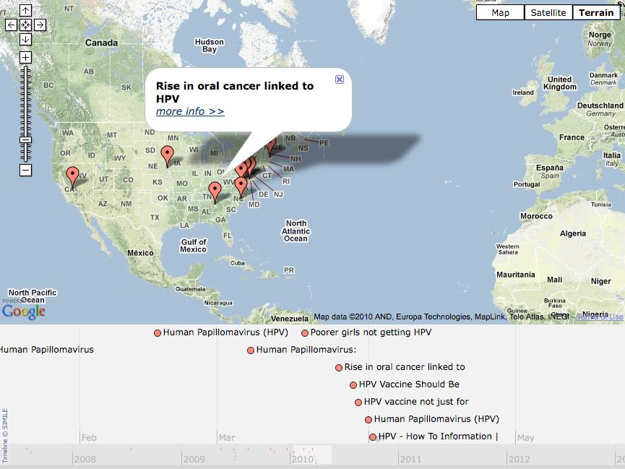
Continuing Work: Opinion Mapping
Human Papillomavirus Vaccine
Murphy, Hsu, Elshamy, Kallumadi, & Volkova (2014)
Notes:
27

Slide 28
Outline
What are Data Science, Big Data, and Analytics?
What Is Informatics? How Is It Relevant to Computer Science?
Applied computational, information science
Domains: arts, sciences, medicine, law
Tasks: analytics, visualization, data/info integration
Motivating Areas, Examples, Sources
Info Visualization, Big Data Analytics, & The Ghost Map
Informatics in the Sciences: Bioinformatics and Beyond
Digital Humanities and Media Arts
Media Sciences: Mass Communications to Text Analytics
Medical and Health Informatics

Slide 29
Outline
What are Data Science, Big Data, and Analytics?
What Is Informatics? How Is It Relevant to Computer Science?
Applied computational, information science
Domains: arts, sciences, medicine, law
Tasks: analytics, visualization, data/info integration
Motivating Areas, Examples, Sources
Info Visualization, Big Data Analytics, & The Ghost Map
Informatics in the Sciences: Bioinformatics and Beyond
Digital Humanities and Media Arts
Media Sciences: Mass Communications to Text Analytics
Medical and Health Informatics

Slide 30
Digital Humanities: Intersection of Computing & The Humanities
Humanities Include... (http://en.wikipedia.org/wiki/Humanities)
Ancient and modern languages
Literature
Philosophy
Religion
Performing arts: music, theatre, dance
Scholarship (http://sites.library.northwestern.edu/dh/)
Presented in digital form
Enabled by digital methods, tools
About digital technology, culture
Building, experimenting with digital technology
Critical of its own digital nature

Slide 31

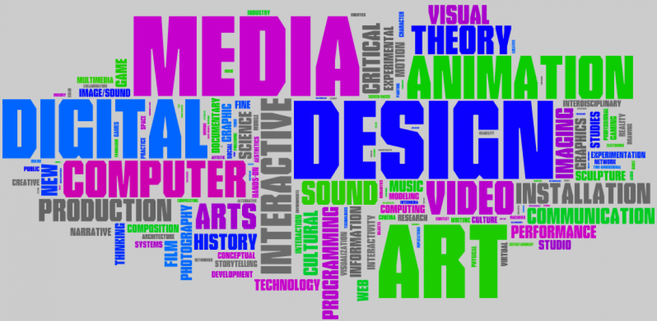
Media Arts
© 2012 St. Paul Public Schools
http://creativearts.spps.org/media_arts
© 2012 Digital Media Program Archive
http://bit.ly/dmpa-blog

Slide 32
Outline
What are Data Science, Big Data, and Analytics?
What Is Informatics? How Is It Relevant to Computer Science?
Applied computational, information science
Domains: arts, sciences, medicine, law
Tasks: analytics, visualization, data/info integration
Motivating Areas, Examples, Sources
Info Visualization, Big Data Analytics, & The Ghost Map
Informatics in the Sciences: Bioinformatics and Beyond
Digital Humanities and Media Arts
Media Sciences: Mass Communications to Text Analytics
Medical and Health Informatics

Slide 33
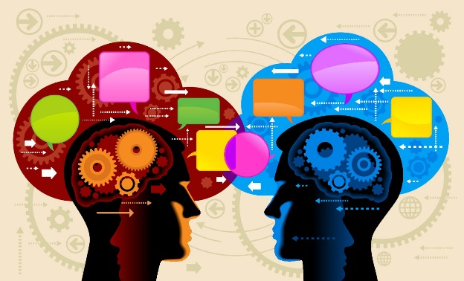
Media Sciences
Entertainment
Computer Graphics: Images, Animation
Computer Games: Design, Production, Game Engines
Immersion: Virtual & Augmented Reality
Computer-Mediated Communication (CMC)
Sociology
Social Media
Information Networks
Cybersecurity, Information Trust, & Risks
Journalism and New Media (Web & Beyond)
Economics
Management
*
Image credit:
NLP Opleidingen Brabant
http://bit.ly/NLP-image

Slide 34
Outline
What are Data Science, Big Data, and Analytics?
What Is Informatics? How Is It Relevant to Computer Science?
Applied computational, information science
Domains: arts, sciences, medicine, law
Tasks: analytics, visualization, data/info integration
Motivating Areas, Examples, Sources
Info Visualization, Big Data Analytics, & The Ghost Map
Informatics in the Sciences: Bioinformatics and Beyond
Digital Humanities and Media Arts
Media Sciences: Mass Communications to Text Analytics
Medical and Health Informatics

Slide 35
Electronic Health Records: Importance and Applications
Data Integration
Adverse drug reactions (ADRs)
Medical history
Information Management
Data warehousing: centralization
Insurance, health care provider, patient
Data Mining and Analytics
Wikipedia, Electronic Health Record http://en.wikipedia.org/wiki/Electronic_health_record

Slide 36
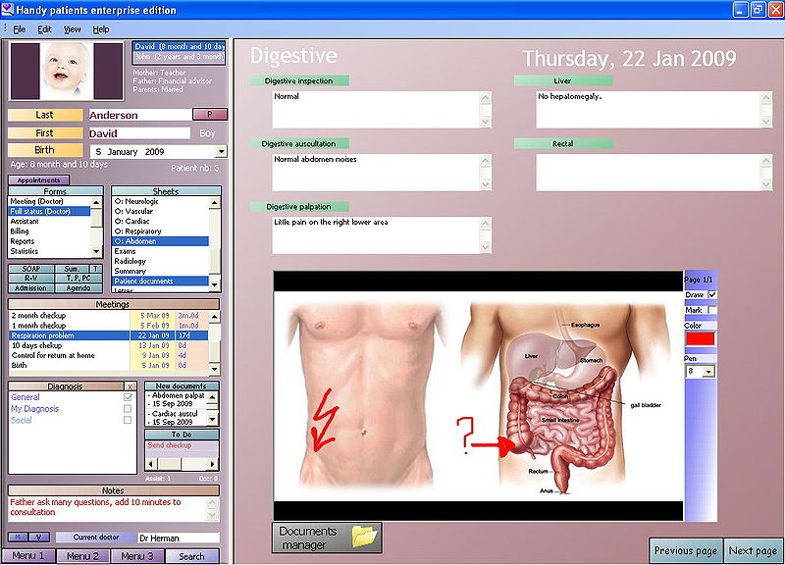
EHRs: Picture Archiving & Communications Systems (PACS)
Wikipedia, Electronic Health Record http://en.wikipedia.org/wiki/Electronic_health_record

